Slide 1
Dosage calculation #3
NUR3260

Slide 2
Weight based medications
Many medications are prescribed by weight – especially in pediatric population
  Basing medications on weight ensures correct dosages

Slide 3
Mg/kg/day
Some prescriptions may be written as milligrams per kilogram of body weight per day
We then need to determine how many milligrams of a medication the client can have per day based on their weight in kilograms
Order states: Administer 20mg/kg/day
Client weighs 112lbs
How many milligrams can they have per day?

Slide 4
Single doses
prescription should then indicate how many doses the client will receive throughout the day
Most often every 4, 6, 8 , or 12 hours (q4, q6, etc...)
Divide total daily by how many times a day client will receive...so:
  Q4 = 6 times a day (24 hours divided by every 4 hours = 6)
  Q6 = 4 times a day
  Q8 = 3 times a day
  Q12 = 2 times a day
So example from last slide = 1,018mg/day
How many mg would be delivered per dose if ordered Q6? What about Q12? Round to nearest whole number

Slide 5
Practice
Provider orders Tobramycin 4mg/kg/day to be administered every 8 hours
Client weighs 60kg
Available: Tobramycin 40mg/2ml
How many ml should the nurse give per dose? (round to whole number)

Slide 6
More practice
Order states: administer lorazepam 0.05mg/kg one time before surgery.
Client weighs 192lbs
Available: Lorazepam 2mg/ml
How many ml will the nurse administer? Round to nearest whole number

Slide 7
Weight based practice
You have on hand hydromorphone (Dilaudid) 4 mg/mL. You need to administer 0.015 mg/kg to a patient who weighs 150 pounds. How many milliliters should you administer? Record your answer using two decimal places.

Slide 8
CONSIDERATIONS
What needs to be in prescription
  Date and time prescription written
  Client’s full name
  Name of medication
  Indication (reason)
  Dose: amount times or frequency of administration and strength
  Route of admin
  Any specific instructions (ex. Take with food or without)
  Signature
Abbreviations to avoid:
  QD – once daily but looks like QID (4 times daily)
  HS – could mean bedtime or half-strength
  DC – could mean discharge or discontinue
What would you do if you have a prescription missing a piece or with one of the above abbreviations?

Slide 9
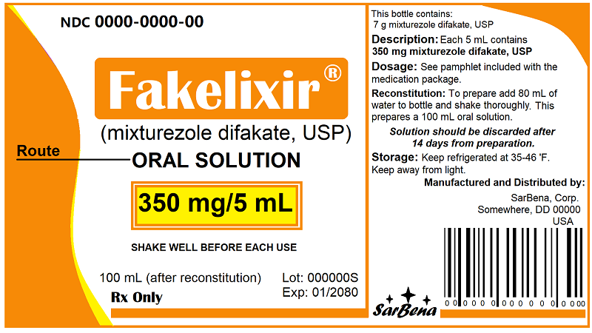
Reading a medication package

Slide 10
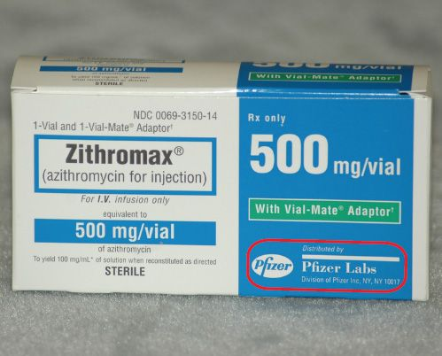
Reading packaging

Slide 11

Questions?

